Slide 1
Final Review

Slide 2
Contents
HTTP
Methods
Response Status Code
REST
AJAX
4-steps
Flasks Models
Columns
Relationships
Functional Programming

Slide 3
Just a review after Midterm
May not cover all
May not appear in exam

Slide 4
HTTP
Methods
Methods | Definitions
GET | Requests a representation of the specified resource
HEAD | requests the headers that are returned if the specified resource would be requested with an HTTP GET method (Decide before downloading large resource)
POST | Sends data to the server
PUT | Creates a new resource or replaces a representation of the target resource with the request payload
DELETE | Deletes the specified resource
PATCH | Applies partial modifications to a resource

Slide 5
HTTP
Methods (RFC2731)
HTTP Methods | Has body | Success response has body | Safe (Read-only) | Idempotent (No side-effects) | Cacheable (stored to be retrieved and used later)
GET | No | Yes | Yes | Yes | Yes
HEAD | No | No | Yes | Yes | Yes
PUT | Yes | No | No | Yes | No
POST | Yes | Yes | No | No | Only if freshness information is included
DELETE | May | May | No | Yes | No
PATCH | Yes | Yes | No | No | No

Slide 6
HTTP
Response Codes (more in MDN)
Code and Status | Definition
200 OK | General status code. Most common code used to indicate success.
201 Created | The request has been fulfilled and resulted in a new resource being created.
204 No Content | The server has fulfilled the request but does not need to return an entity-body
304 Not Modified | If the client has performed a conditional GET request and access is allowed, but the document has not been modified
400 Bad Request | The request could not be understood by the server due to malformed syntax.
401 Unauthorized | The request requires user authentication.
403 Forbidden | The server understood the request, but is refusing to fulfill it.
404 Not Found | Resource is not found.
409 Conflict | The request could not be completed due to a conflict with the current state of the resource.

Slide 7
HTTP
Rest
Can be understand in both client and server side
Source contained
Not HTTP, but a protocol independent style

Slide 8
AJAX
Step 1: Get a new XMLHttpRequest object
var xhr = new XMLHttpRequest();
Step 2: Open
xhr.open("GET", "data.txt", true);
1st : HTTP Methods
2^{ed}: URL/URI
3rd: Asynchronous switch ()
If this value is false, the send() method does not return until the response is received. If true, notification of a completed transaction is provided using event listeners.

Slide 9
AJAX
Step 3: Send
xhr.send(body)
Body(Optional)
A Document
Step 4: Handling Response
calls an event handler for each change in the state of the XMLHttpRequest object
xhr.onreadystatechange = function() { ... }

Slide 10
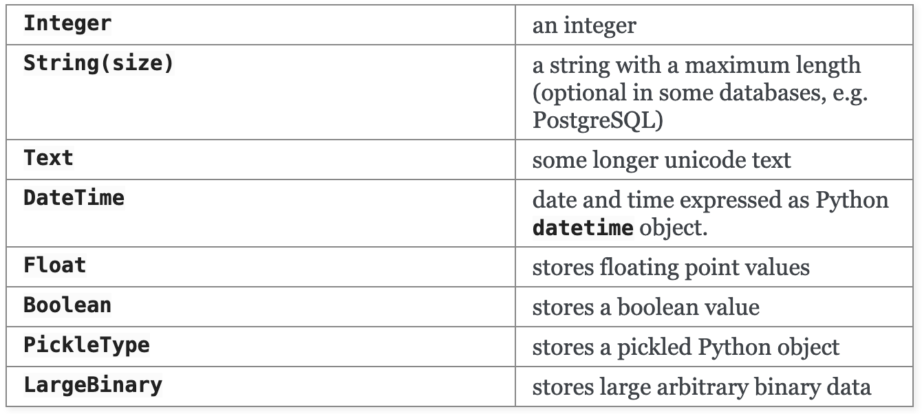
Flask Models
Save tables as objects and links as entries/attributes
Column
Column(Name, type, Options)
Type:

Slide 11
Flask Models
Columns
Options
Primary_key
Nullable
Unique

Slide 12
Flask Models
Relationship
Primary key: Attribute that uniquely identifies each row
Foreign keys: Attributes that refer to rows in other tables
One-to-Many:
One (Person): addresses = db.relationship('Address', backref='person', lazy=True)
Many (Address): person_id = db.Column(db.Integer, db.ForeignKey('person.id'), nullable=False)
Many-to-Many:
Association Table
association_table = db.Table('association', db.Model.metadata, db.Column('left_id', db.Integer, db.ForeignKey('left.id')), db.Column('right_id’, db.Integer, db.ForeignKey('right.id’)))
children = db.relationship("Child", secondary=association_table)

Slide 13
Flask Models
Relationship
Lazy-ness (lazy = ‘###’)
select (Default): Loads when the parameter is accessed
joined: Loaded in initial query
subquery: Works like joined but instead SQLAlchemy will use a subquery
dynamic: SQLAlchemy will return another query object which you can further refine before loading the items

Slide 14
Functional Programming
JavaScript
var new_array = arr.map(function callback(currentValue[, index[, array]])
arr.reduce(callback[, initialValue])
var newArray = arr.filter(callback(element[, index[, array]])[, thisArg])
Python
map(function_to_apply, list_of_inputs)
filter(function_to_apply, list_of_inputs)
reduce(function_to_apply, list_of_inputs)
enumerate(list_of_inputs)

